Slide 1
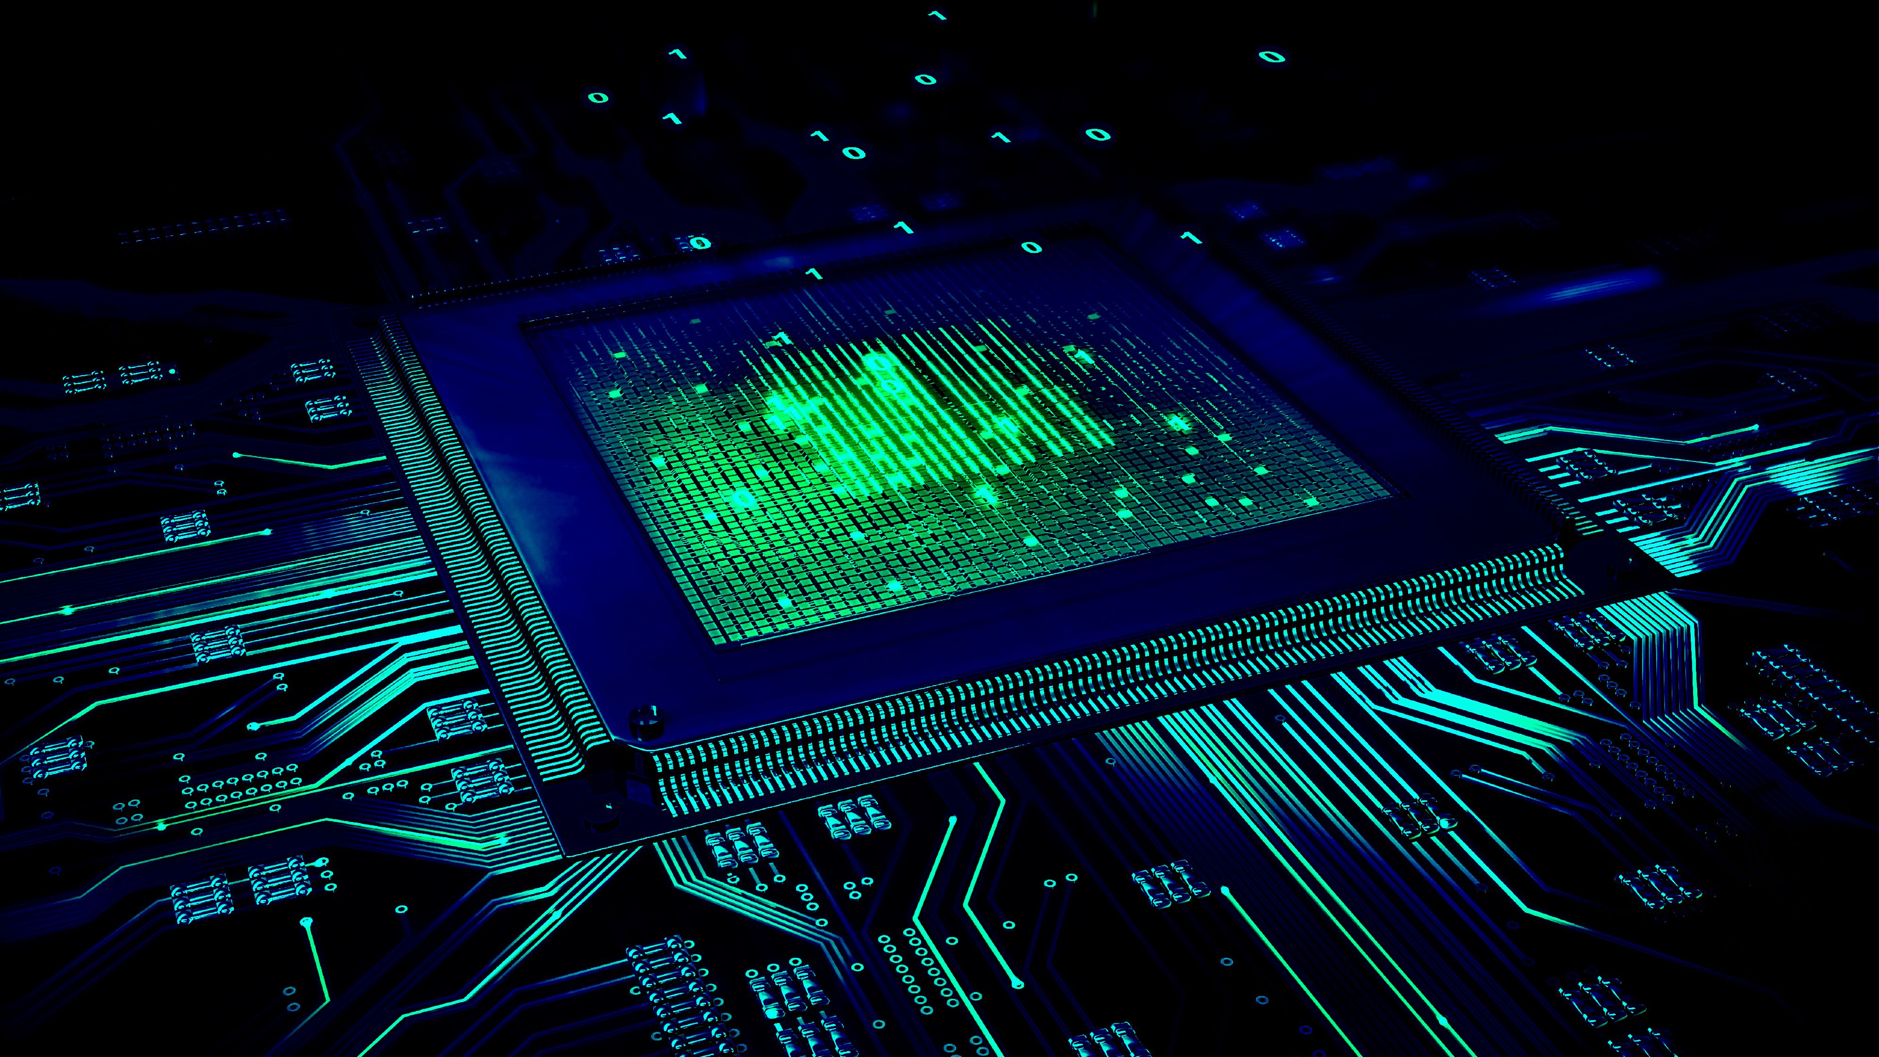
Digital Logic families
Characteristics of Digital ICs
CSE 211- DEPT
Lecturer Uzma Hasan, CSE department, MIST

Slide 2
Semiconductor devices
Semiconductor devices mainly are of 2 types: Bipolar and Unipolar devices
>>In Bipolar devices, operation is due to both minority and majority carriers. All p-n junction based devices fall in this category. Example: Bipolar Transistors or BJT are “Bipolar” devices because they operate with both types of charge carriers (holes and electrons).
>>Unipolar means only one set of pole assigned to the device, flow of current is only in one direction due to flow of electrons permitted in only one direction. The Field Effect Transistor is a “Unipolar” device that depends only on the conduction of either electrons (N-channel) or holes (P-channel).
Based on these devices, digital ICs have been made which are commercially available.

Slide 3
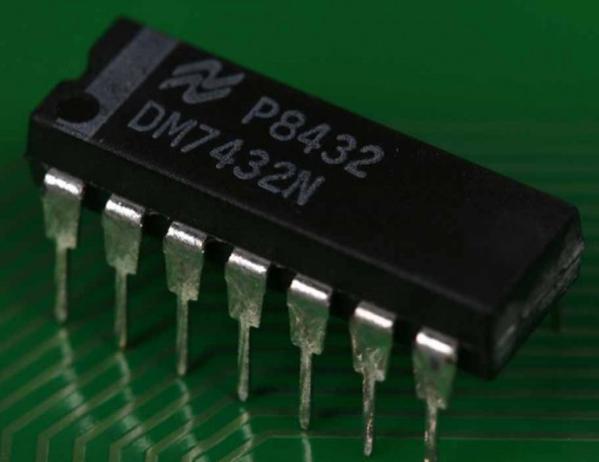
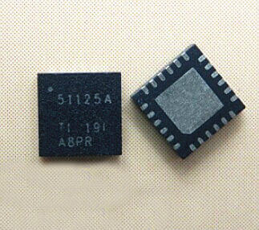
Ics and their uses
An Integrated Circuit (IC) is a small wafer, usually made of silicon, that can hold anywhere from hundreds to millions of transistors, resistors, and capacitors.
These extremely small electronics can perform calculations and store data using either digital or analog technology.
Digital ICs use logic gates, which work only with values of ones and zeros.
A low signal sent to a component on a digital IC will result in a value of 0, while a high signal creates a value of 1.
Digital ICs are usually found in computers, networking equipment, and most consumer electronics.

Slide 4
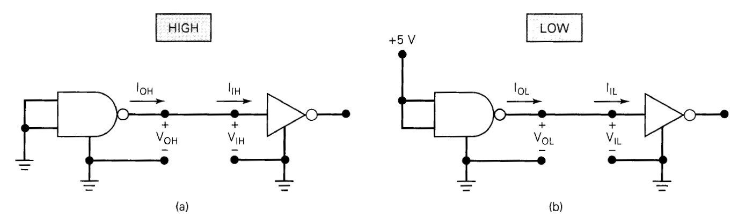
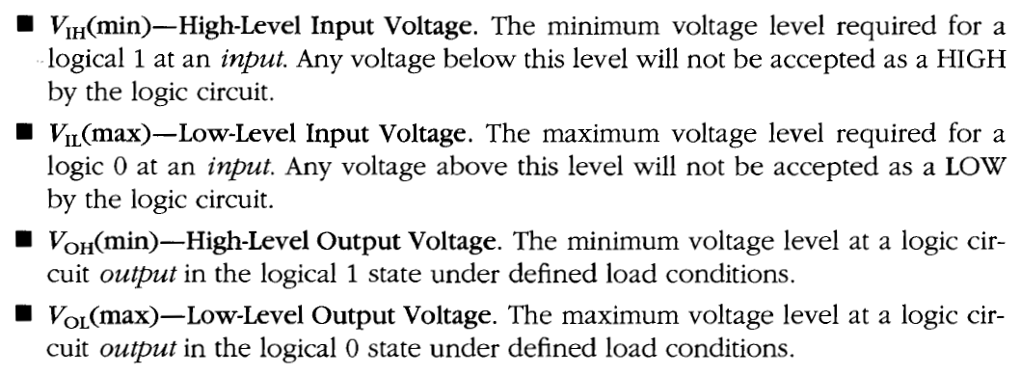
IC terminologies

Slide 5
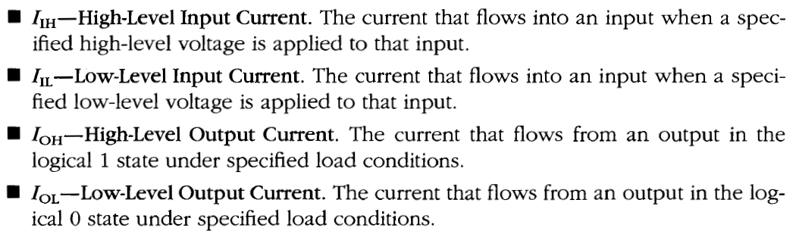
IC terminologies

Slide 6
Characteristics of Digital ICs
Propagation delay
Power dissipation
Noise immunity
Figure of Merit
Fan in
Fan out

Slide 7
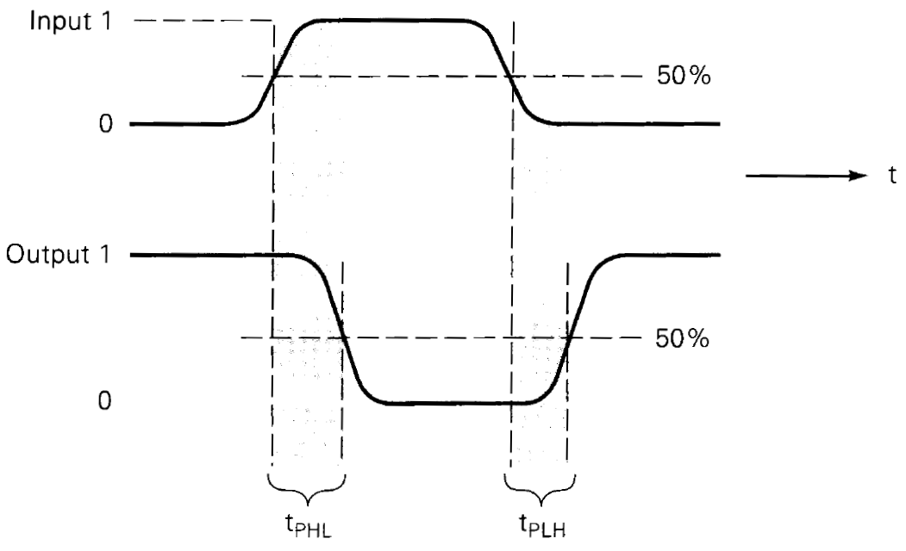

Propagation delay
A logic signal always experiences a delay while going through a circuit
Propagation delay typically refers to the rise time or fall time in logic gates. This is the time it takes for a logic gate to change its output state based on a change in the input state.
Figure: Propagation Delays

Slide 8

Power dissipation
Every IC requires a certain amount of electrical power to operate
This power is supplied by one or more power-supply voltages connected to the power pin(s) on the chip
Power dissipation is the amount of power required by an IC or the amount of power dissipated in an IC. It is determined by the current, Icc, that is drawn from the Vcc supply, and is given by Vcc x Icc
Icc is the average value of Icc(0) and Icc(1)
This power is specified in milliwatts

Slide 9
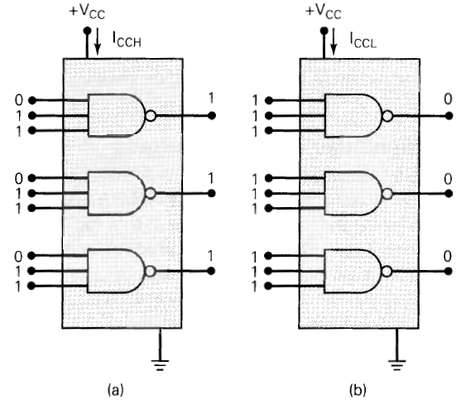
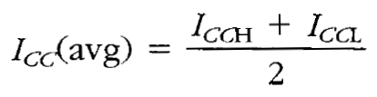
Power dissipation
Figure: NAND chip

Slide 10
Noise immunity
Stray electric and magnetic fields may induce unwanted voltages, known as noise, on the connecting wires between logic circuits.
This may cause the voltage at the input to a logic circuit to drop below V_{lH (min)} or rise above V_{lL(max)} and may produce undesired operation.
So, the circuit's ability to tolerate noise signals without causing unwanted changes in the output voltage is referred to as the noise immunity
A quantitative measure of which is called Noise Margin
High-state noise margin : VNH = VOH (min) – VIH (min)
Low-state noise margin : VNL = VIL (max) – VOL (max)

Slide 11
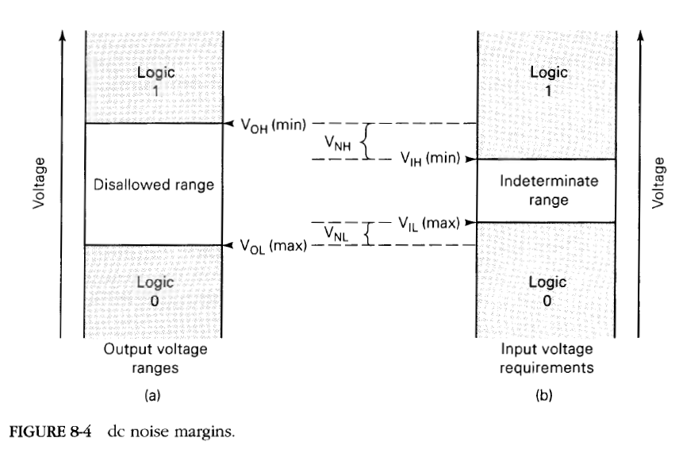
Noise immunity

Slide 12
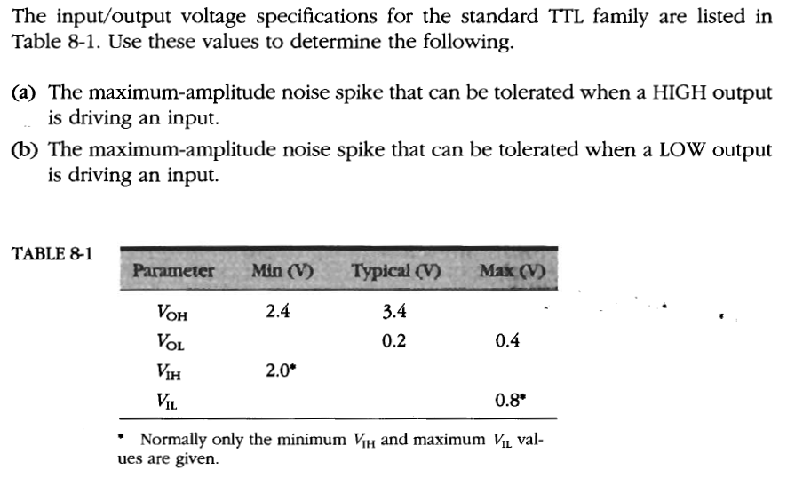
Noise immunity

Slide 13
Figure of Merit
The Figure of Merit of a digital IC is defined as the product of speed and power. The speed is specified in terms of propagation delay time expressed in nanoseconds.
Figure of Merit = propagation delay time(ns) x power(mW)
It is specified in pico joules (ns * mW = pJ)
A low value of speed-power product is desirable. In a digital circuit, if it is desired to have a high speed (low propagation delay time), then there is a corresponding increase in the power dissipation and vice versa.

Slide 14
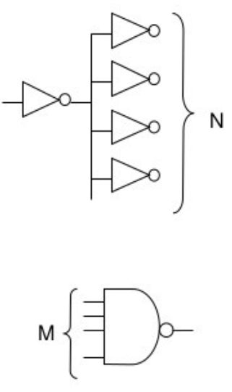
Fan in & Fan out
Fan Out: The fan-out (also called loading factor) is defined as the maximum number of inputs (load) that can be connected to the output of a gate (driving gate) without degrading the normal operation. Exceeding the specified maximum load may cause a malfunction because the circuit does not guarantee to supply any demanded power greater than it’s limit. Gates with large fan-out are slower.
Fan In: The fan-in defined as the maximum number of inputs that a logic gate can accept. If number of input exceeds, the output will be undefined or incorrect. Gates with large fan-in are bigger and slower.

Slide 15
References
Chapter 8 - Digital Systems Principles and Applications (8th edition) by Ronald J. Tocci

Slide 16
Self study
Advantages of ICs or why ICs are used widely?
Review Questions (1 to 4 ) from Chap 8 Pg no - 423

Slide 17
Thank you
Take care

